Slide 1

Budget Management system
Android Application Project
Guided By – Prof. Shehrevar Davierwala

Slide 2

Developed By
Urmi Vyas
Insiya Maldeviewala
Dipti Joliya
Niyati Joshi

Slide 3


Explored Projects :
There are several projects for android app which we have explored . They are :
1) Notes , Alarm Clock , Calendar – These are the inbuilt application that are already existing on a mobile phone so there is not much use.
2) Ecommerce Application – These type of application needs large functionalities so we can’t develop as it is time consuming and we have not much time .
3) Weather Application -This project requires real-time weather info and forecasting. Hourly and weekly forecasting with interactive maps.

Slide 4
Introduction of the Project
A budget management app is a digital tool designed to help individuals or businesses manage their finances more effectively.
With this app, users can track their income, expenses, and savings goals in one centralized location.
The app usually provides various features like automatic categorization of expenses, setting up a budget, tracking bills.
Using a budget management app is an effective way to take control of one's finances and achieve financial goals.
It eliminates the need for manual tracking, provides real-time insights into spending patterns, and helps users make informed financial decisions.

Slide 5
Scope & Current Problems of the project
It will have various options to keep record of expenses (for example Food, Travelling Fuel, Salary etc.)
In today’s busy and expensive life, we are in a great rush to make moneys, but at the end of the month we broke off. As we are unknowingly spending money on title and unwanted things. So, we have come over with the plan to follow our profit.
Here user can define their own categories for expense type like food, clothing, rent and bills where they have to enter the money that has been spend and likewise can add some data in extra data to indicate the expense.
This application can be useful for housewife's ,students ,hostel-student.
The main purpose of this application is store a our day to day use and to keep record our expenses.

Slide 6



Explored Existing Applications
Money Lover/ Wallet / My Money
It has confusing UI.
Some time it is difficult to work with these apps as it has hard functionalities.
In this application various advertisement are there so it creates disturbances.

Slide 7

2nd application
21 Day Challenge
In this application you can only store your 21 days data .
And that next day you can start with 1st day that's why we can not save our whole month record so we avoid this application.

Slide 8
Functionality
Login/Register
To access the functionality of an application user must have their account.
Record your incomes
Uses can add their incomes with fields as – Title , Amount , Category and Date .
Record your expenses
User can enter their expense with fields as – Expense Name , Amount and Date
Shows detailed report of your expense date-wise
User can view the report of all the expenses done at specific date

Slide 9
Required Hardware-Software
Hardware for Developing :
Ram – Minimum 8 GB or more
Windows – 7 or later
Software for Developing
Android Studio
JDK.
Firebase
Hardware for Client-Side
Android Device
Ram – 4 GB or more
Software for Client-Side
OS of android

Slide 10
SWOT Analysis
Strength :
Time-saving: An expense management app can save time by eliminating the need for manual data entry and simplifying the expense tracking process. This can free up time for users to focus on other important tasks.
Convenience: An expense management app can make it easier and more convenient for users to track their expenses.
Large Users :It is intended for every person who wants to manage expenses so it will target Large Android users.

Slide 11
SWOT Analysis
Weakness:
Limited to android users : As the app is only developed for android users so IOS users can't use this.
Non Customizable: The app is not customizable so it may not be suitable for more complex accounting needs and as per users preference.
This application is only in English Language.

Slide 12
SWOT Analysis
Opportunity:
Personalization: By offering greater customization and personalization options, expense management app can cater to the unique needs and preferences of individual users. This could include features such as custom expense categories, personalized budgets, and alerts based on specific spending patterns.

Slide 13
SWOT Analysis
Threats:
Competitors: With so many expense management apps available on the market, competition can be fierce. If a similar app is more popular or offers more features, it can be difficult for the app to gain traction and attract new users.

Slide 14
Intend Audience and Reading Suggestions.
The document is intended for all the stakeholder customers and the developers , designers , coders, testers and maintainers. The reader is assumed to have basic knowledge of Mobile OS , and user accounting along with knowledge and understanding of DFDs and various other diagrams such as Use case diagrams, activity diagrams and ER diagrams . User must understand the flow of the applications and various redirections too.

Slide 15
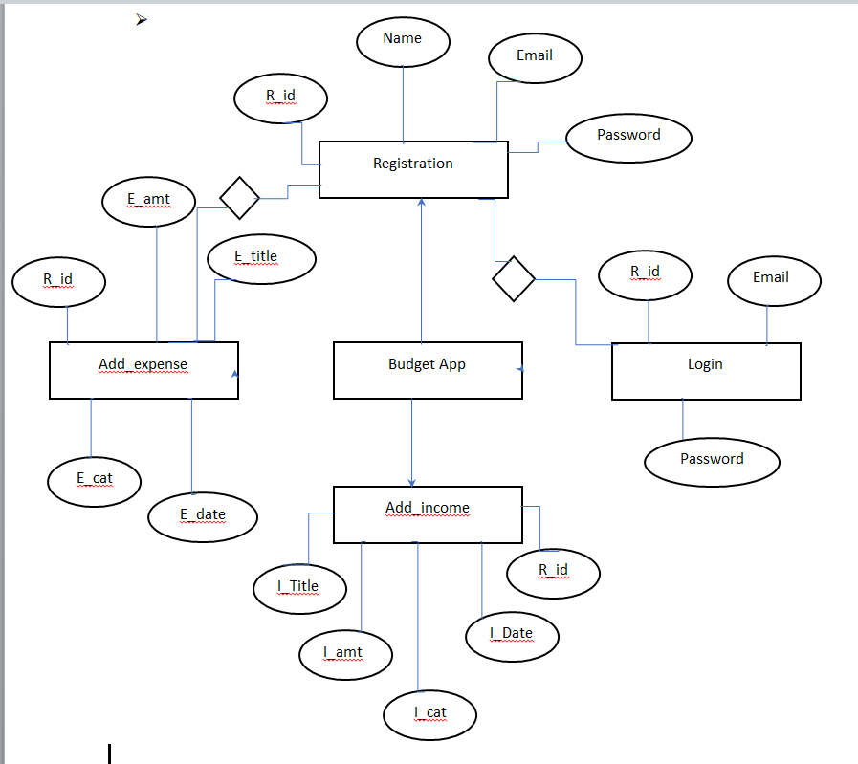
E-R Diagram:-

Slide 16
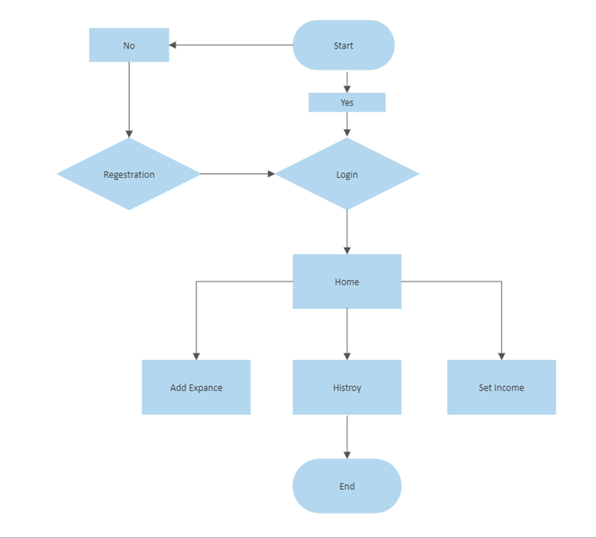
Flow Chart :-

Slide 17
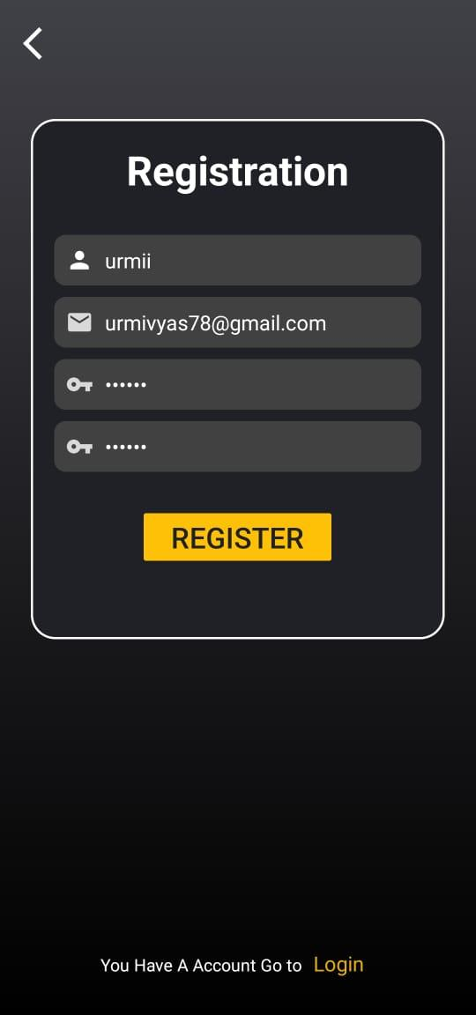
Registration Page
This is Registration page , where the user can register themselves and create their account.
Only registered users can access the application after logging in .
You have to enter a valid username , email id , password and confirm password .
If you have already have an account and want to login , then you can click on below link of “Login” and it will redirect you to a login page.

Slide 18
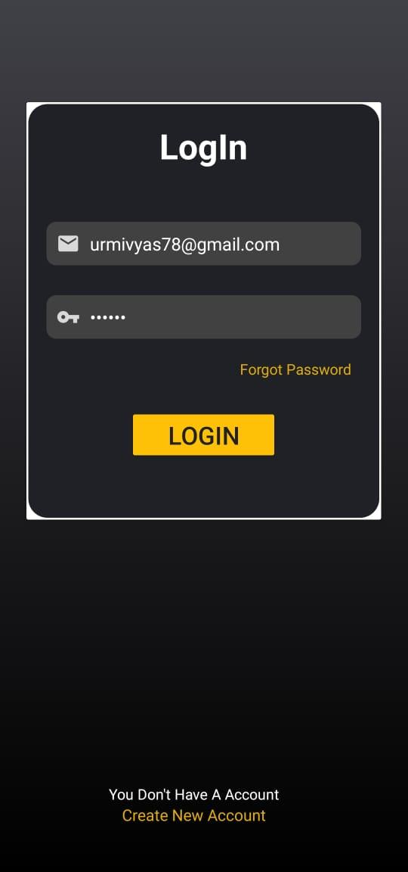
Login Page
This is login page , where the registered user can login and access the application.
You have to use your email id and password which was set at the time of registration.
If you don’t have an account and want to register than you can click on below link of “Create new Account ” and it will redirect you to a registration page.

Slide 19
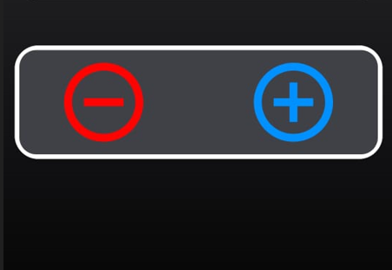
Home Page
This is Home page , after login to the application the first page which will appear is a home page.
Plus (+ ) means to add income. When you click on this symbol you will be redirect to add income page to add your incomes .
Minus (-) means to add expenses. When you click on this symbol you will be redirect to add expense page to add your expenses .

Slide 20
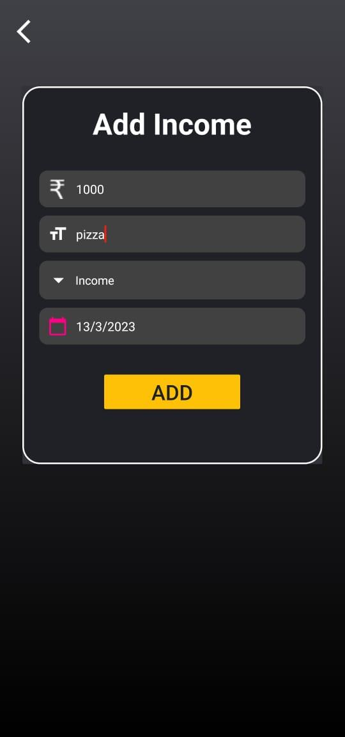
Add Income Page
This is Add Income page , which will add your incomes to the application.
In first field you have to add amount , then in title field you can enter the title for income , then select category like – Income , Loan , or Salary .
At last select the date when you have received this income and click on add button.

Slide 21
References
For our application development as well as for the preparation of the software requirements specifications, we took various references from various websites and even a reference of an existing application is taken into consideration. The websites which we refer are as follows:
www.you-tube.com
We have use this website to solve some error and some tutorials for effects.
www.androiddevelopers.com
We have use this search engine solve dependency and others libraries.

